Slide 1

Japan Needs More Proactive Mindsets
IMAMURA Yuto

Slide 2

・The tradition of focusing on the same opinion
・The attitude to fit in with the company rather than selling yourself.

Slide 3
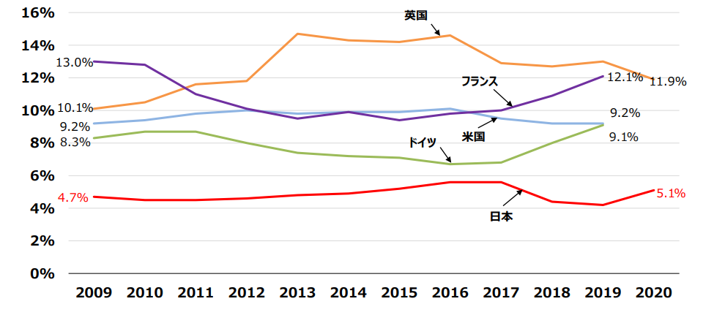

The rate of establishing a company
Japan is 5.1%
America are 9.2%
French is 12.1%

Slide 4
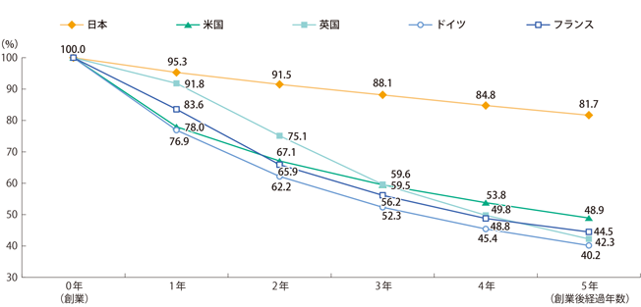

The success rate of establishing a company

Slide 5

We have to do more challenges.

